Slide 1


We are
VERDANT GLOBAL
BUSINESS SOLUTIONS LTD.
www.verdantglobal.org
Notes:
Cover 1

Slide 2

AGENDA
Programs
Date | 6 JULY 2020
01
ABOUT VERDANT GLOBAL
BUSINESS SOLUTIONS LTD.
06
OUR PRODUCTS & SERVICES
HR ADMINISTRATION
OUR VISION | MISSION | CORE VALUES
OUR PRODUCTS & SERVICES
CONFERENCES & WORKSHOPS
02
07
03
OUR PRODUCTS & SERVICES
COMPENSATION & SALARY BENEFITS
08
OUR PRODUCTS & SERVICES
ACCOUNTING SERVICES
04
OUR PRODUCTS & SERVICES
HR POLICIES & PROCEDURES
09
CLIENTS WE HAVE WORKED WITH
05
OUR PRODUCTS & SERVICES
PERFORMANCE MANAGEMENT
10
CONTACT US
VERDANT GLOBAL BUSINESS SOLUTIONS LTD.
www.verdantglobal.org

Slide 3




ABOUT US
VERDANT GLOBAL BUSINESS SOLUTIONS is a fully registered Human Resource Outsourcing and Consulting firm. We partner with our clients to provide flexible Human Resource support services to businesses of all sizes and across all industries, essential for the growth of both corporate and retail clients.

Slide 4


ABOUT US
Title Text Here
Our range of services is a one-stop shop for all your business needs. We design our business support services for a wide range of companies, spanning various sectors.
Our team of dedicated professionals, can assist you to
re-engineer your business with value-added human resource solutions. Our team of experts cover all Human resource
discipline.
VERDANT GLOBAL BUSINESS SOLUTIONS LTD.
www.verdantglobal.org

Slide 5
ABOUT US
Vision | Mission | Goals
Vision
Mission
Core Values
To be recognized as the leading and most innovative Human Resource Consulting and Outsourcing Firm in Ghana and beyond.
Achieve client satisfaction through the
provision of innovative and strategic HR
solutions and professional service.
Excellence
Integrity
Professional Ethics
Respect
Customer Delight
VERDANT GLOBAL BUSINESS SOLUTIONS LTD.
www.verdantglobal.org

Slide 6

OUR PRODUCTS
& SERVICES
We have a wide a range of HUMAN RESOURCE product
and services which we package to meet the specific needs of clients

Slide 7

OUR HR PRODUCT & SERVICES
1
STAFF OUTSOURCING/ MANPOWER SUPPLY
2
EMPLOYMENT APPLICATION PROCESSING
3
INTERVIEWING CANDIDATES.
4
PREPARING JOB DESCRIPTIONS.
RECRUITMENT
5
PREPARING EMPLOYMENT CONTRACTS/LETTERS.
“
With over 1000 successful recruitment for several leading brands in the country, Verdant Global business solution Ltd. can assure you of the best results.
6
FACILITATING ORIENTATION
FOR NEW EMPLOYEES.
VERDANT GLOBAL BUSINESS SOLUTIONS LTD.
www.verdantglobal.org

Slide 8

OUR HR PRODUCT & SERVICES
1
COMPENSATION & BENEFITS PROGRAMME.
2
INTERACTIVE SALARY SCALE.
3
STAFF WELFARE / HEALTH & SAFETY PROGRAMME.
COMPENSATION / SALARY
& BENEFITS
4
STAFF SELF-HELP PROGRAMME –
EG. CREDIT UNION ETC.
“
We are expects in managing employee compensation and benefits policy-making. The term "compensation and benefits" refers to the discipline as well as the rewards themselves.
VERDANT GLOBAL BUSINESS SOLUTIONS LTD.
www.verdantglobal.org

Slide 9

OUR HR PRODUCT & SERVICES
We prepare / design the following:
1
HUMAN RESOURCE ADMINISTRATIVE POLICIES.
2
STAFF CONDITIONS OF SERVICE MANUAL.
HUMAN RESOURCE
POLICIES & PROCEDURES
“
Human Resources policies are continuing guidelines on the approach of which an organization intends to adopt in managing its people. They represent specific intent of the organization on different aspects of Human Resource management such as Recruitment, Promotion, Compensation, training, etc,.
VERDANT GLOBAL BUSINESS SOLUTIONS LTD.
www.verdantglobal.org

Slide 10
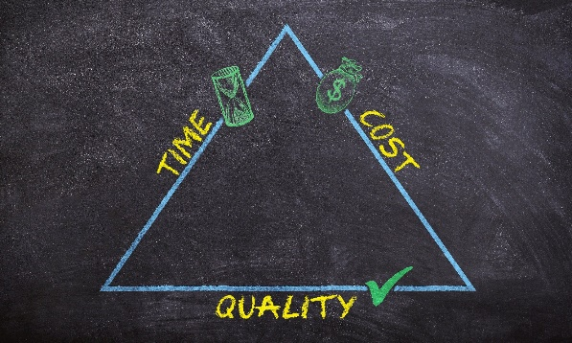
OUR HR PRODUCT & SERVICES
1
PREPARE PERFORMANCE MANAGEMENT POLICY FOR STAFF.
TRAIN CEOS, HR MANAGERS,
SUPERVISORS, TEAM LEADERS IN PERFORMANCE MANAGEMENT.
2
TRAIN CEOS, HR MANAGERS, SUPERVISORS, TEAM LEADERS IN PERFORMANCE
3
4
TRAIN CEOS, HR MANAGERS, SUPERVISORS, TEAM LEADERS IN PERFORMANCE
PERFORMANCE MANAGEMENT
“
process of ensuring that set of activities and outputs meets an organization’s goals in an effective and efficient manner. Performance Management can focus on the performance of an organization, a department, an employee, or the processes in place to manage particular tasks.
VERDANT GLOBAL BUSINESS SOLUTIONS LTD.
www.verdantglobal.org

Slide 11

OUR HR PRODUCT & SERVICES
1
GENERAL HR ADMINISTRATIVE SUPPORT.
2
HR AND ADMINISTRATIVE SETUP
3
PERSONNEL REGISTRY
4
COORDINATION OF HR DOCUMENTATION.
HUMAN RESOURCE
ADMINISTRATION
HR SOFTWARE PROGRAMME MANAGEMENT.
5
“
Human resource administration is the management of the overall employment experience of people working at an organization. In many companies, a team of human resources professionals is responsible for implementing effective workforce management and employee development.
VERDANT GLOBAL BUSINESS SOLUTIONS LTD.
www.verdantglobal.org

Slide 12

OUR HR PRODUCT & SERVICES
1
HR STRATEGIC PLANS FOR SHORT-TERM, MEDIUM & LONG-TERM.
STRATEGIC HUMAN RESOURCE PLANNING FOR NGOS AND BUSINESS INSTITUTIONS
2
3
JOB EVALUATION
4
STAFF SKILLS AUDIT
HR STRATEGIC DIRECTIONS
5
PREPARING EMPLOYMENT CONTRACTS/LETTERS.
“
HR Strategy is a designation for a long-term plan created to achieve objectives in the field of human resource and human capital management and development in the organization.
6
SUCCESSION PLANNING FOR BUSINESS GROWTH.
VERDANT GLOBAL BUSINESS SOLUTIONS LTD.
www.verdantglobal.org

Slide 13
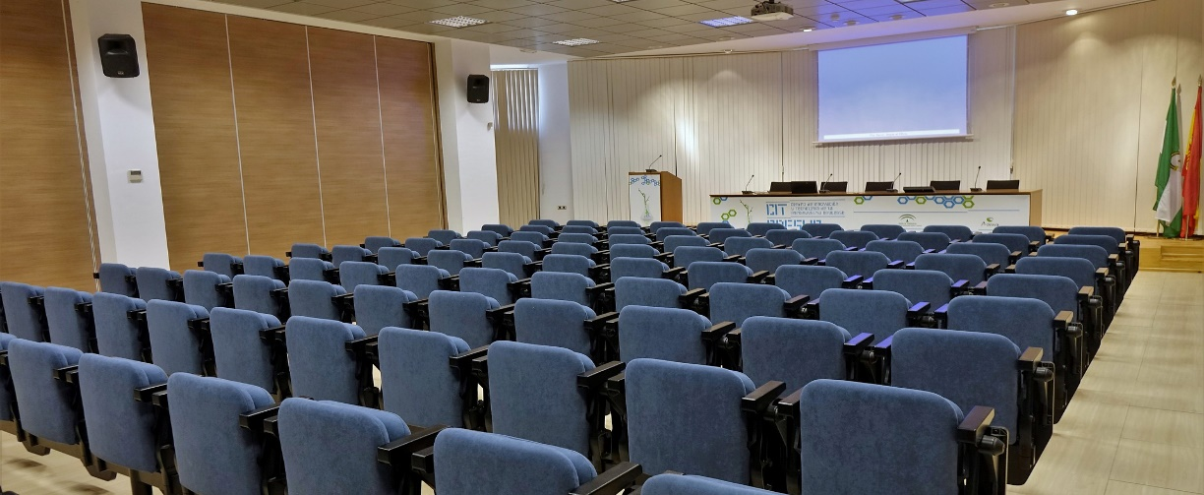
OUR HR PRODUCT & SERVICES
CONFERENCES & WORKSHOPS
“
We organize Conferences and Workshops for CEOs, Managers, Supervisors and Team Members across industries
VERDANT GLOBAL BUSINESS SOLUTIONS LTD.
www.verdantglobal.org

Slide 14

OUR HR PRODUCT & SERVICES
ACCOUNTING SERVICES
“
Verdant Global Business Solutions Ltd. offers Accounting and basic Book Keeping function services to small, medium and large scale business entities. No matter the nature of business or service the organization offers, we are able to cover its accounting needs.
VERDANT GLOBAL BUSINESS SOLUTIONS LTD.
www.verdantglobal.org

Slide 15

OUR HR PRODUCT & SERVICES
SERVICES OFFERED
1. Stock Taking
2. Book Keeping Functions
3. Preparation of Periodic Financial Reports
4. Preparation of Contract Accounts
5. Preparation of Bank Reconciliation Statements
6. Preparation of Payment Vouchers
7. Assists Employers in the Calculation of PAYE/SSNIT contributions of staff
8. Assists Clients in Monitoring Sales Personnel
9. Preparation of Final Accounts
VERDANT GLOBAL BUSINESS SOLUTIONS LTD.
www.verdantglobal.org

Slide 16


Slide 17


VERDANT GLOBAL
BUSINESS SOLUTIONS LTD
0244 470 578
P.O. Box MD 1693. Madina - Accra
CONTACT US
@
Inquiries.vgbs@outlook.com
Verdant Global Business Solutions
@verdantgbs

Slide 18

THANK YOU
For your Attention

